Slide 1
Exploring Linux Filesystems
Chapter 3

Slide 2
Objectives
After completing this chapter, you will be able to:
Understand and navigate the Linux directory structure using relative and absolute pathnames
Describe the various types of Linux files
View filenames and file types
Use shell wildcards to specify multiple filenames
Display the contents of text files and binary files
Search text files for regular expressions using grep
Use the vi editor to manipulate text files
Identify common alternatives to the vi text editor used today

Slide 3
The Linux Directory Structure (1 of 3)
Directory
Used to organize other files into a logical tree structure
Stored in a filesystem of a specific partition in the hard disk or SSD
Absolute pathname
Pathname from the root directory to a certain file or directory
Root
Top level directory
Referred to using /root

Slide 4
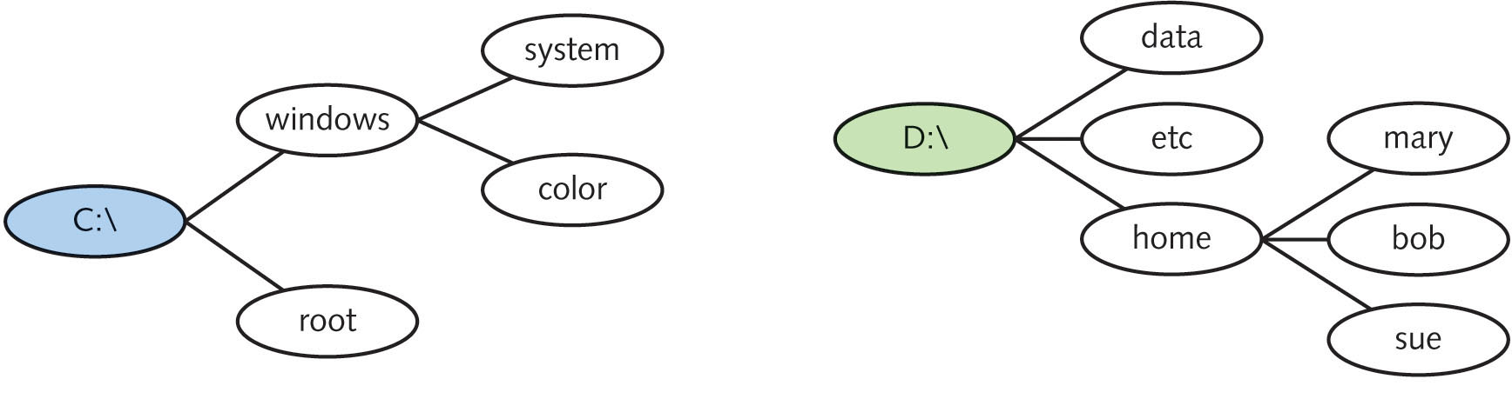
The Linux Directory Structure (2 of 3)
Figure 3-1: The Windows filesystem structure

Slide 5
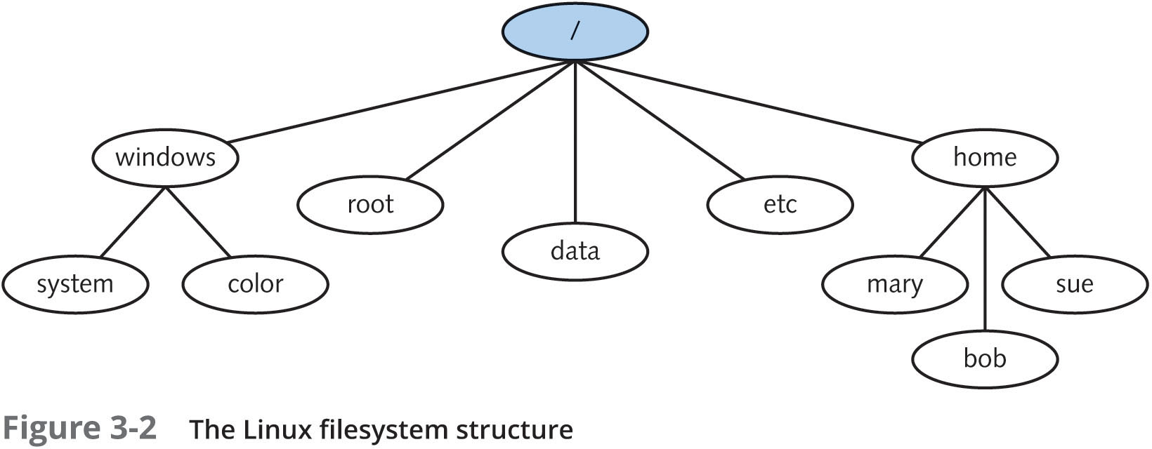
The Linux Directory Structure (3 of 3)
Figure 3-2: The Linux filesystem structure

Slide 6
Changing Directories (1 of 2)
Home directory
Unique to each user account
The ~ metacharacter can be used to refer to home directory
Print working directory (pwd) command
Displays current directory in the directory tree
Change directory (cd) command
Change the current directory
Relative pathname
Pathname of target file or directory relative to current directory

Slide 7
Changing Directories (2 of 2)
Parent directory
Directory one step closer to the root of the tree
Referred to by two dots (..)
Subdirectory
Directory residing within another directory
Tab-completion
Pressing the Tab key fills in remaining characters
BASH shell feature
Alerts user if there is more than one possible match

Slide 8
Viewing Files and Directories
Point of a directory structure
Organize files into an easy-to-use format
This sections covers various types of files and filenames
As well as different commands used to select filenames for viewing

Slide 9
File Types
Text files: contain configuration information
Binary data files: store information such as common functions and graphics
Linked files: files that have an association with one another
Special device files: files that represent different devices on the system
Named pipe files: identify channels that pass information from one process in memory to another
Socket files: allow a process on another computer to write to a file on the local computer while another process reads from that file

Slide 10
Filenames
Filename
Identifier given to a file
Up to 255 characters (rarely longer than 20 characters)
Alphanumeric characters, underscore (_), dash (-), and period (.)
Filename extensions
Identifiers following a period (.) at end of filename
Indicate file type
Most files on Linux do not have filename extensions

Slide 11
Listing Files (1 of 3)
1s command: displays files in a directory
1s –F command appends a special character at the end of each filename displayed to indicate the type of file
1s –l command can be used to provide a long listing for each file in a certain directory

Slide 12
Listing Files (2 of 3)
File components
File type character
List of permissions on the file
Hard link count
Owner of the file
Group owner of the file
File size
Most recent modification time
Filename

Slide 13
Listing Files (3 of 3)
File command: displays file type of any file
Argument indicates what file or files to analyze
Identifies between different types of executable files
Identifies empty files
Hidden files: files not normally displayed to user
Configuration files often hidden
Filenames start with a dot (.)
ls –a command: displays hidden files

Slide 14
Wildcard Metacharacters (1 of 2)
Simplify commands specifying more than one filename on the command line
Can match the entire filename or portions of filenames
Can be used with most Linux filesystem commands

Slide 15
Wildcard Metacharacters (2 of 2)
Table 3-3: Wildcard metacharacter
Metacharacter | Description
* | Matches 0 or more characters in a filename
? | Matches 1 character in a filename
[aegh] | Matches 1 character in a filename—provided this character is either an a, e, g, or h
[a-e] | Matches 1 character in a filename—provided this character is either an a, b, c, d, or e
[!a-e] | Matches 1 character in a filename—provided this character is NOT an a, b, c, d, or e

Slide 16
Displaying the Contents of Text Files (1 of 2)
Concatenation: view an entire text file on the terminal screen
The cat command: displays contents of a text file to the screen
The -n option: displays line number of each line in the file
Log files: contain records of events
Most recent events are appended to end of the file
The tac command: displays contents of a text file in reverse order
Head command: displays the first ten lines of a file
Tail command: displays the last ten lines of a file

Slide 17
Displaying the Contents of Text Files (2 of 2)
Large text files can not be viewed using the cat command
Screen will only fit a portion of the file
The more command: displays text files page-by-page
The less command: same as more command, but can also use arrow keys
The more and less commands can be used with output of other commands

Slide 18
Displaying the Contents of Binary Files
To view contents of binary files, you typically use the program that created the file
The strings command: searches for and displays text characters in a binary file
Might indicate purpose of binary file
The od command: displays contents of file in octal format (numeric base 8 format)
The -x option displays contents of the file in hexadecimal format (numeric base 16 format)

Slide 19
Searching for Text Within Files
Text tools
Commands that search for and manipulate text
Such as database information
Regular expressions (regexp)
Text wildcards that ease the search for specific text
Recognized by several text tools and programming languages

Slide 20
Regular Expressions (1 of 2)
Different from wildcard metacharacters
Wildcard metacharacters are interpreted by the shell, whereas regular expressions are interpreted by a text tool program
Wildcard metacharacters match characters in filenames (or directory names) on a Linux filesystem, whereas regular expressions match characters within text files on a Linux filesystem
Wildcard metacharacters typically have different definitions than regular expression metacharacters
More regular expression metacharacters are available than wildcard metacharacters

Slide 21
Regular Expressions (2 of 2)
Regular expressions are divided into two different categories
Common regular expressions: available to most text tools
Extended regular expressions: less common and available in only certain text tools

Slide 22
The grep Command (1 of 2)
The global regular expression print (grep) command: displays lines in a text file that match common regular expressions
The egrep command: displays lines in a text file that match extended regular expressions
The fgrep command: does not interpret any regular expressions and returns results much faster

Slide 23
The grep Command (2 of 2)
Requires two arguments
Text to search for
Files to search
Case sensitive
For case-insensitive search, use –i option
Matches patterns of text
Unable to discern words or phrases unless they are specified

Slide 24
Editing Text Files
Most system configuration is stored in text files
As is commonly accessed information such as e-mail and program source code
Most Linux distributions come with several text editors
Editors that can be used on the command line
Editors that can be used in a GUI environment

Slide 25
The vi Editor (1 of 2)
One of the oldest and most popular text editors for UNIX OSs
Linux equivalent of vi: vim
Standard on most Linux distributions
Advantage is portability, not usability
Used on Unix and Linux
The vi editor supports regular expressions
Can perform over 1000 different functions for the user

Slide 26
The vi Editor (2 of 2)
The vi editor is called a bi-modal editor
Command mode: performs text editing tasks not related to inserting text
Such as deleting text, copying text, saving changes to a file, and exiting the vi editor
Insert mode: inserts text, but nothing else
Press the Esc key to return to command mode
User environment is customizable
Through settings that can be altered at the : prompt

Slide 27
Other Common Text Editors (1 of 2)
GNU Emacs (Editor MACroS) editor: offers comparable functionality to vi
Nano editor: text editor that uses Ctrl key combinations for performing functions
The gedit editor: graphical text editor functional in a GUI environment

Slide 28
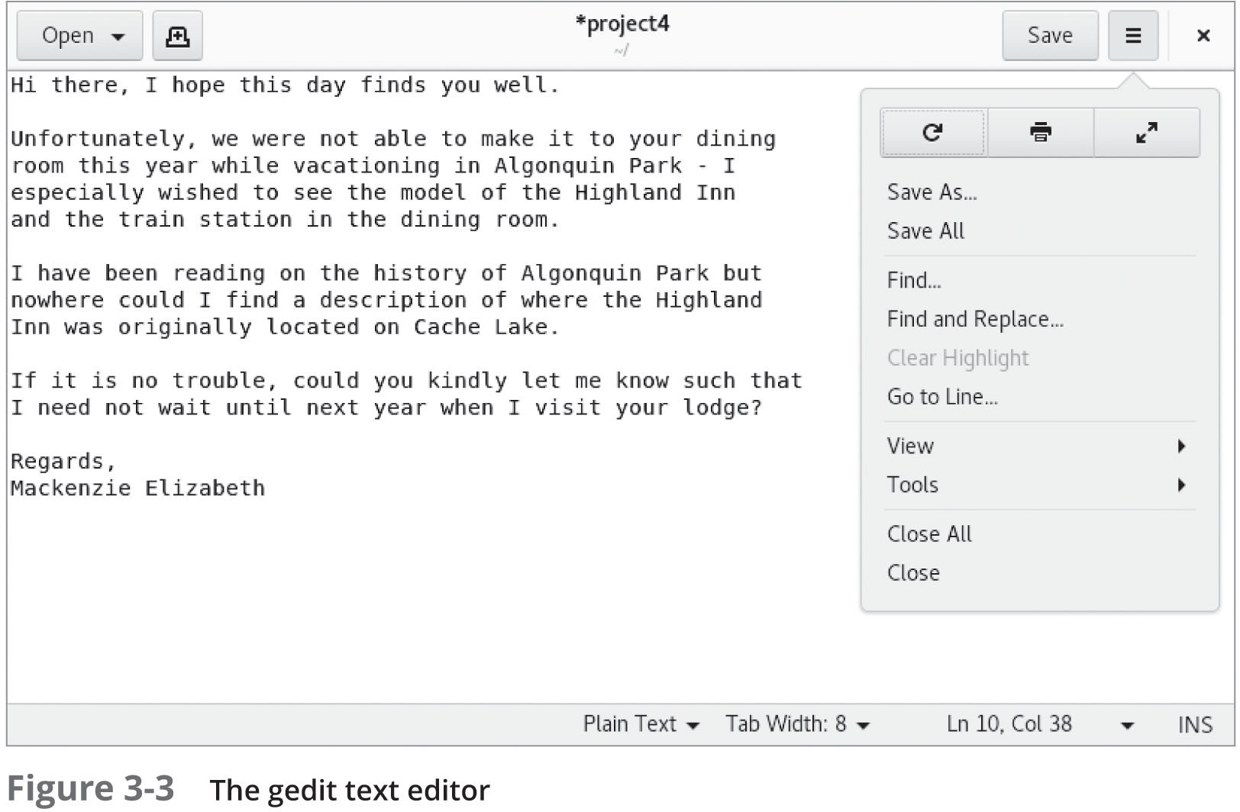
Other Common Text Editors (2 of 2)
Figure 3-3: The gedit text editor

Slide 29
Summary (1 of 2)
The Linux filesystem is arranged hierarchically
Series of directories store files
The ls command is used to view filenames
Wide range of options to modify views
Wildcard metacharacters are special keyboard characters
Simplify selection of several files when using common Linux file commands
Text files are the most common file type
Contents can be viewed by several utilities: head, tail, cat, tac, more, and less

Slide 30
Summary (2 of 2)
Regular expression metacharacters can be used to specify certain patterns of text
Used with certain programming languages and text tool utilities such as grep
Although many command-line and graphical text editors exist, vi (vim) is a powerful, bimodal text editor
Standard on most UNIX and Linux systems

